Slide 1
Team Foundation Overview
David Lemphers
TeamForce
http://ihaveidee.blogspot.com

Slide 2

Objectives
Discuss Software Configuration Management (SCM)
Learn about the SCM features in Team System
Understand the architecture of Team Foundation
Learn about the options for extensibility
Notes:
So our objectives here are really to understand the issues around configuration management and see how Team System addresses them.

Slide 3

Agenda
Software Configuration Management
Team Foundation Capabilities
Team Foundation Architecture
Notes:
We’ll start off by talking briefly about software configuration management before delving into the new toolset.

Slide 4
What is SCM?
The set of strategies employed for managing the integrity and evolution of a base of source code.
Encompassing:
Source Code Control
Work Item Tracking
Build Management
Release Management
Notes:
Introducing the core concepts of SCM

Slide 5
SCM Market
$880M Industry in 2001
Forecast: $1.54B Industry in 2006
Market dominated by tools providing workflow management
IBM/Rational, MERANT, SERENA, and CA dominate the market today
Notes:
Clearly SCM is a big problem and it has a big market
The lack of total integration presents a great opportunity for a new kind of integrated software development suite.
An effective SCM strategy must enable you to do things like
Work on multiple versions of a product simultaneously
Merge changes from one release to another
Have multiple devs working on the same files simultaneously
Trace bug fixes and other issues back to their origin
Manage builds and releases effectively

Slide 6









Releases
Lists
(Bugs, Requirements, etc)
Management
Questions
Team
Communication
Process
Guidance
Source Code
Assets
Notes:
These are the central issues faced by all development teams.
Lists – Bugs, requirement etc typically managed by lots of different systems in e.g. Excel, custom bug tracking systems etc
Process Guidance – People using lots of different processes and methodologies whether formal or home grown. We need tools which assist us in following process.
Management Questions – What state is the project in now ? How much code churn do we have in our nightly builds ? etc – Usually very difficult to answer
Source Code Assets – Often the most important thing to manage; currently a bit painful with Visual SourceSafe
All of these require the team to communicate well in order to finally build the product and release it
Currently managing all of this is somewhat painful to say the least due largely to a lack of good tool integration.
The testing tools don’t integrate with the bug tracking tools. The bug tracking tools don’t integrate with the source code control system
Organizations create rules like: “You must include the bug ID in your checkin comment” and then developers ignore or forget them.
Source code changes are rarely confined to a single file. How do you track the changes across files? Need to treat them as an entity (Source Depot’s change lists)
Where you have multiple product branches in your source control repository, how do you know which changes have already been migrated and how do you ensure that an entire change is migrated?
When doing automated builds, how do you version the source and the tools for your builds to reduce the burden of creating and maintaining a build process. You also want to know which bugs/features are addressed by which builds.
Some products (i.e. Rational) have attempted a level of integration with kind of band-aided solutions. Microsoft felt that it was time for something completely new to give users the best possible experience.

Slide 7
Developer Needs?
Standard version control
Historical traces from code to work item
  What was the requirement?
  What bug was being fixed?
Parallel development
Tools for interruptible workflow
Remote version control
Notes:
So different team members all have their own requirements from an SCM strategy.
Developers require all these features without ever having to leave Visual Studio !
The SCM process must be injected into their daily activities in a very non-intrusive way

Slide 8
Tester Needs?
Version control for test artifacts
Notification of available bug fixes
Release notes for individual builds
Notes:
How many times have you had to manually compile lists of which bugs/issues have been fixed by which build?
This is crying out for automation and integration.

Slide 9
Project Lead Needs?
Reports on code churn
Status updates derived from check-ins
Rapid start-up for new team members
Change Management assistance
  Simple change migration between branches
  Identify fixes needing migration
  Easily back-out a fix
Notes:
Wouldn’t it be great to not have to spend time asking all your team for status updates all the time but instead receive automatic email notification as work is being checked in.

Slide 10






Visual Studio Team System
Visual Studio
Team Architect
Visual Studio
Team Developer
Visual Studio
Team Test
Process and Architecture Guidance
Application Modeling
Dynamic Code Analyzer
Load Testing
Visual Studio Industry Partners
Logical Infra. Modeling
Static Code Analyzer
Manual Testing
Deployment Modeling
Code Profiler
Test Case Management
Unit Testing
Code Coverage
Class Modeling
Visio and UML Modeling
Team Foundation Client
VS Pro
Change Management
Change Management
Reporting
Integration Services
Visual Studio
Team Foundation
Reporting
Work Item Tracking
Project Management
Work Item Tracking
Project Site
Notes:
<click to highlight>
Should probably include MSBuild in the highlights here since it plays a vital role in any SCM process. Anyone coming to the VS-Integration session will learn all MsBuild.
So Visual Studio Team System and specifically Team Foundation adopt a process-oriented approach to SCM via a tightly integrated set of tools and services.

Slide 11
Agenda
Software Configuration Management
Team Foundation Capabilities
Team Foundation Architecture
Notes:
Let’s drill into the specific capabilities of the Team Foundation tools now.

Slide 12




Visual Studio Team Foundation
Integrated Platform for Collaborating on Software Development Projects.
Work Item Tracking
Source Code Control
Reporting
Build Automation
Team Communications
Notes:
Provides world class tools in each of these areas and more importantly tightly integrates them with each other as well as with Visual Studio
Team Foundation is designed to support iterative development.
-All of the items are work items and all of the tools are different views onto the work items.
-All work items are in a single Team Foundation database.
-You can sort, schedule, query, triage, and manage all work items together.

Slide 13
Guiding Principles
Productive
Short learning curve
Minimal administrative overhead
Integrated
Tools integrated tightly
Automates common tasks
Extensible
Customizable for your process
Integrates with 3rd party tools
Capable
Remotely accessible
Robust, secure, scalable
Notes:
Being familiar Windows tools, they have a very short learning curve and require very little in the way of operational maintenance since they are using SQL Server at the backend. Also, all of the existing and well known concepts from tools like Visual Sourcesafe have been brought forward into the new SCC tool.
All the tools are based on the Team Foundation Server and it’s data warehouse and are tightly integrated with each other as well as with Visual Studio. Want to be able to utilise our entire SCM process without ever having to leave Visual Studio.
Automate tasks such as associating changes with work definitions as well as answering some of those management questions; e.g. which changes fixed this bug?
Of course, people may already have a large investment in some particular tools and/or processes and so Visual Studio provides excellent customization as well as a platform for integration and extensibility. You can manipulate the behaviour of VSTS tools to fit your team.
Finally, problems such as those encountered by Visual Sourcesafe users had to be eliminated for enterprise developers. In other words, the tools had to be extremely capable of supporting large, distributed development teams and projects and we’ll see how that’s been achieved in during this session.

Slide 14
What is VS Team Foundation?
Work Item Tracking
Source Code Control
Reporting
Build Automation
Team Communications
Notes:
So lets now talk about work item tracking which is something all development teams already do in one form or another.

Slide 15
Work Item Tracking
Concepts
Work Item
  Bug, task, requirement, etc
Artefacts
  Work Items
  Source files
  Changesets
  Builds
Linking
  Work items can be linked to other artefacts
Notes:
A work item is a new term which really generalises or abstracts the concept of a bug. It is used to define any unit of information which has e.g. workflow, state transitions and can be assigned etc. For example, a bug, task, requirement, scenario etc
Artefacts is a general term used to describe software configuration items.
Changesets are the product of a check-in operation and are a new concept
They describe a group of associated file modifications allowing for simplified administration and workflow accounting
They are given a unique identifier for tracking
The ability to link work items to other artefacts is key to an effective SCM strategy.
Linking work items to source files and changesets allows you to track e.g. which changes dealt with a particular requirement or which files were changed in order to correct a particular bug.
It is also important to be able to easily track which work items are in which builds.

Slide 16
Tracking Changes
How do we account for the source changes being introduced to the system?
Changes need to be accounted for
  Why was the change made?
  Who authorized the change?
Work needs traceability to source
  What change fixed this bug?
Source comments aren’t always enough
Notes:
These kinds of tracking and auditing requirements are met by the new work item tracking system and it’s ability to link artifacts.
All of this is done in a very unobtrusive way using just Visual Studio again facilitating easier team communication.

Slide 17
Work Item Tracking
Not just bugs, work items!
  Bugs, tasks, requirements, DCRs, …
The foundation for software process
Integrates with the tools you already use
Linking to other SCM artefacts
  Key to facilitating communication
  …and an integrated SCM strategy
Notes:
It’s about more than just tracking bugs.
People currently use lots of different tools for tracking these things. A significant number manage bugs in Excel and tasks in MS Project. With the round-tripping feature, you can continue to work with these tools. You can actually create a project plan in MS Project, import it into the work item tracking system to create work items, and then automatically update the project plan as team members complete the tasks assigned to them.
The ability to link work items to other SCM artefacts such as Changesets for full traceability and auditing. It goes further than that however. You can easily identify which source files have been changed in one release but not migrated to another yet. You can further identify which bugs/requirements have been satisfied by those changes.
Work Items really are the foundation for your software process. As you move work through requirements gathering, design, production and release, all of your work items go through the process with you.

Slide 18
Work Item Tracking
Custom Work Item Types
Every organization works differently
  You must be able to customize
Each type consist of:
  Fields, form, rules, states
Build on standard methodologies
  Visual Studio ships with MSF
Notes:
As with all the Team System tools, extensibility is a major theme.
In WIT, this is enabled through the ability to fully customise all aspects of work items and work item types.
This include the actual fields stored with them, how they appear in the UI and the rules and workflow associated with them.
These are then surfaced in your software development process through the methodology templates just like the supplied work items and types.

Slide 19
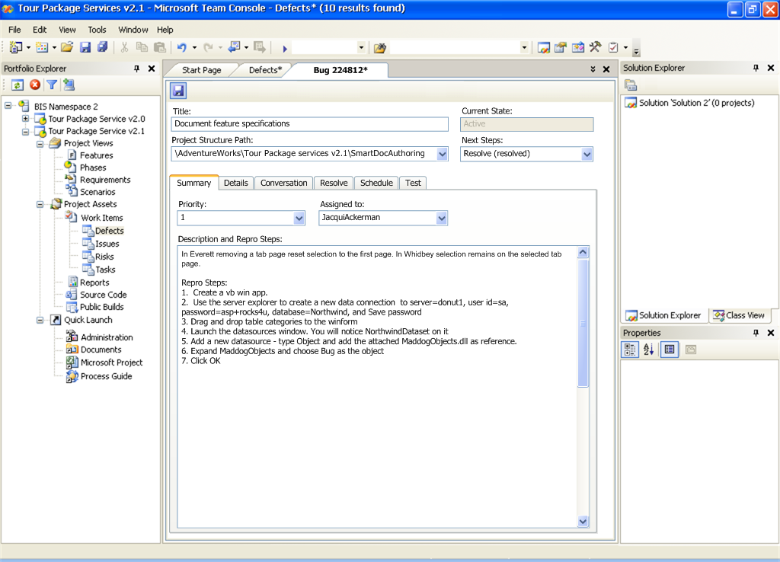
Visual Studio Work Item View
Team Project
Explorer
Shared project context links multiple VS solutions
Work Item
Access
Valid work item types defined per portfolio project
Work Item Form
Customized per work item type
Notes:
So here’s a quick look at work item tracking inside of Visual Studio.
Work item tracking is embedded in VS. There is a team project explorer. Addresses key issue of every project has own notion of explorer. Shows all artifacts related to the project. Is extensible, so can have plugged in node for 3rd party or partner. It is how people navigate to get to a WI.
The actual layout to all these fields, windows is all customizable. You can add or remove tabs not relevant to your company. VS has a query builder (e.g., I want all WI that are in an active state). There is a triage view, where you have a results list of various forms.
Using the new Portfolio Explorer, you can write your own queries using the query builder and even customise the columns returned in the results view.
You can open individual work items as documents within VS and there is also a triage view with the list of results at the top and the work item details at the bottom.
Microsoft have been using ProductStudio for WIT for years and this is basically an enhanced Product Studio fully integrated into Visual Studio
You can also update/resolve work items as well as create brand new ones all from within Visual Studio
So work items can be modified and reassigned by anyone with appropriate permissions. They are tracked in reports, scheduled using MsProject and can be managed in Excel.
Teams can define their own work item types with their own fields, state transitions and workflow rules.
Developers use work items to prioritze their work and notify testers and other devs when a fix has been done for example.
Architects, designers and other team members can create and assign work items to record issues and track progress toward the completion of their goals.

Slide 20
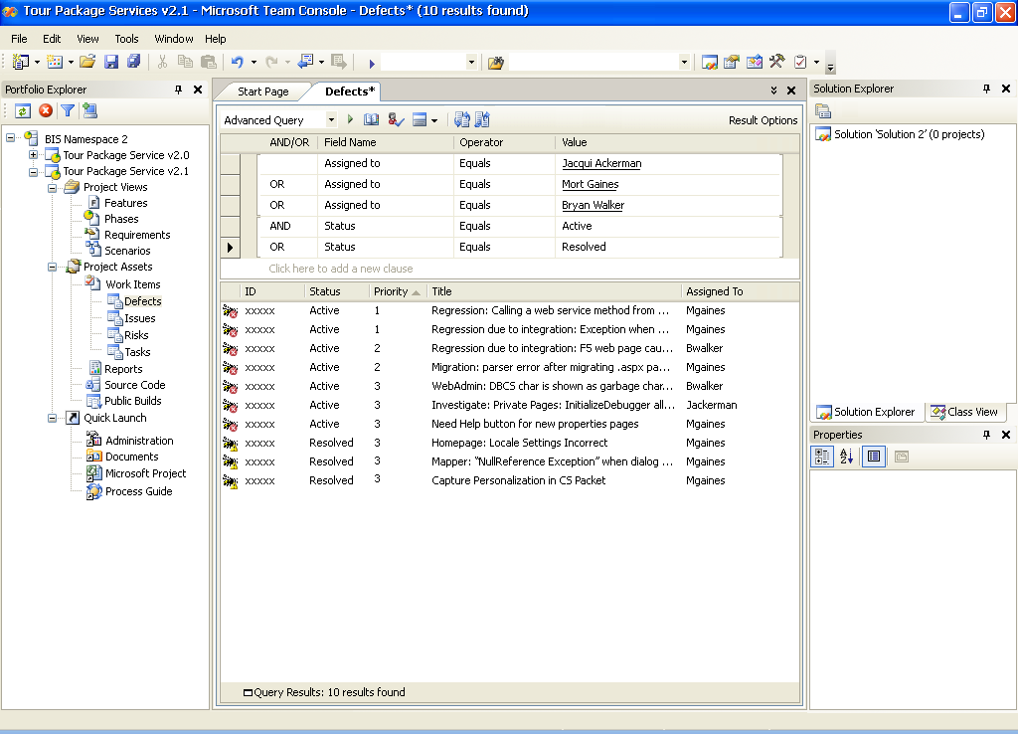
Visual Studio Query View
Query Builder
Flexibly define queries, query across multiple types
Results List
Sort by Columns
Notes:
There is not currently a web interface to the WIT in V1, we will build that in V2.
Talk about Team Foundation Client: E.g., User Acceptance Testers would use the Team Foundation Client. Does not have all the debuggers, compilers, etc.

Slide 21

Work Item Tracking
Notes:
This walkthrough demonstrates how work items are implemented and followed through a complete project in Visual Studio 2005 Team System.
See associated Walkthrough (Tracking Work Items). Talking points are in the walkthrough.
Notes:
Using the new Portfolio Explorer, you can write your own queries using the query builder and even customise the columns returned in the results view.
You can open individual work items as documents within VS and there is also a triage view with the list of results at the top and the work item details at the bottom.
Microsoft have been using ProductStudio for WIT for years and this is basically an enhanced Product Studio fully integrated into Visual Studio
You can also update/resolve work items as well as create brand new ones all from within Visual Studio
So work items can be modified and reassigned by anyone with appropriate permissions. They are tracked in reports, scheduled using MsProject and can be managed in Excel.
Teams can define their own work item types with their own fields, state transitions and workflow rules.
Developers use work items to prioritze their work and notify testers and other devs when a fix has been done for example.
Architects, designers and other team members can create and assign work items to record issues and track progress toward the completion of their goals.

Slide 22
What is VS Team Foundation?
Work Item Tracking
Source Code Control
Reporting
Build Automation
Team Communications
Notes:
Let’s turn our attention now to the subject of Source Code Control.

Slide 23

Visual SourceSafe
Considered industry’s easiest to use version control tool
Often first SCM tool encountered by developers
Not considered a full featured SCM tool
Not appropriate for large scale software development
Notes:
One of the first questions which usually comes up here is what about Visual SourceSafe so let’s get that one out of way first.
SourceSafe is alive and kicking
VSS R&D continues
New release with VS 2005 – Includes HTTP access via a Web Service interface
SourceSafe for small teams
1-5 users
Version control only
Team Foundation for larger teams
5-500 users
Complete SCM system

Slide 24
Team Foundation
Source Code Control
3-tier, web service architecture
Built on SQL Server for robust, transaction-based version control
Integration with other VSTS tools for automated workflow management
Implementation of advanced SCM concepts
Migrate from
  VSS, ClearCase, Source Depot
Notes:
Team Foundation has a completely new Enterprise Level Source Code Control system
It is in no way a port of either VSS or Source Depot but has been developed from scratch.
The goals of Hatteras are as described earlier
Ease-of-use
Leverage VSS
Low administration – no release manager required
Tight Tool Integration
Scalability
Support small to Microsoft sized teams
It provides a very process-oriented approach to SCM.

Slide 25
SourceSafe vs Team Foundation
 | Visual SourceSafe 2005 | Visual Studio 2005 Team Foundation
Description | Version Control | Integrated Software LifeCycle Suite
Team Size | Individuals and Small Teams | Scalable
Storage | File System | SQL Server 2005
Security | Application specific | Windows Integrated
Remote Access | New Web Service for VS Integration | Optimized Web Service
Notes:
VS Team Foundation is built using a 3-tier architecture based on SOAP and ASP.NET Web Services. It uses SQL Server 2005 at the backend so is built using the same architecture that Microsoft recommends the rest of us use. It really is about as robust, secure and scalable as it gets.
All SCC activity happens via Web Service protocols so MS really are eating their own dog food here.

Slide 26
Source Code Control
Features
Complete version control feature set
  Everything from VSS plus….
Innovative new SCC features
  Integrated checkin
  Parallel development
  Atomic checkins
  Remote development
Strong integration with other VS Team System tools
Notes:
As we said earlier, a lot of the familiar ‘concepts’ from VSS have been carried forward and enhanced.
Unlike VSS, Hatteras tracks more than just file changes. Specifically, it tracks additions, deletions and renames automatically. How many of us have forgotten to add new files to VSS and thereby broken the build! This scenario will no longer be possible.
We also have atomic checkins thanks to using SQL Server (Yukon) as the repository. If a single file fails to checkin then the whole changeset will be rolled back and there is never a danger of another developer getting a partial set of files.
As with all the Team System tools, SCC is tightly integrated with Visual Studio and Team Foundation giving us our software configuration management solution.
So now let’s drill down a bit into some of these new features.

Slide 27
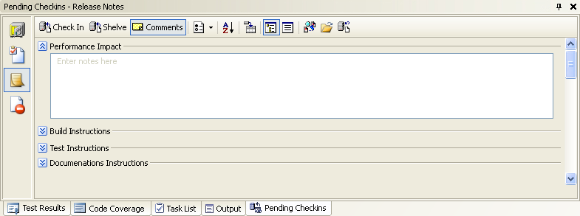
Source Code Control
Integrated Checkin Experience
Combines changes, comments, work items, policy, e-mail
Captures valuable data relationships
Customizable for your process
Notes:
The Pending Check-Ins window shown on this slide (which already exists in VS 2003) has been greatly enhanced in VS 2005 to allow more information to be collected as part of the check-in process.
Imagine a typical check-in process today
Firstly, you must remember to run static analysis and unit test your work
Then you must get it reviewed/approved by a buddy
Then you would need to resolve all the ‘issues’ or work items relating to the changes you have made
You may then have to compile changeset documentation
Finally, you would need to notify other team members probably via email and templates
Typically, the above process might involve as many as 4 or 5 different applications just to check in some code which is all a bit painful
Now, with VSTS you never even have to leave Visual Studio.
The pending check-ins window constantly tracks all changes, additions, deletions and renames so no more forgetting to check-in new files !!
Checking in can also automatically change the state of the work items and assign them to the testers as part of your process workflow.
You can also use the ‘diff’ tool directly from this window for e.g. code reviewing. You can even plug in your own diff tool if you prefer.
-----------------------------------------------------------------
We will see all of this in action in a moment.

Slide 28
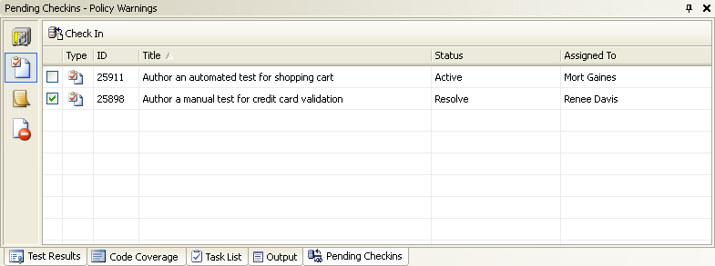
Associate Work Items
User Simply checks associated work items
Notes:
Using the Pending Check-Ins window you can use the new channel bar on the left to view your assigned work items and simply tick the ones associated with your changes.

Slide 29
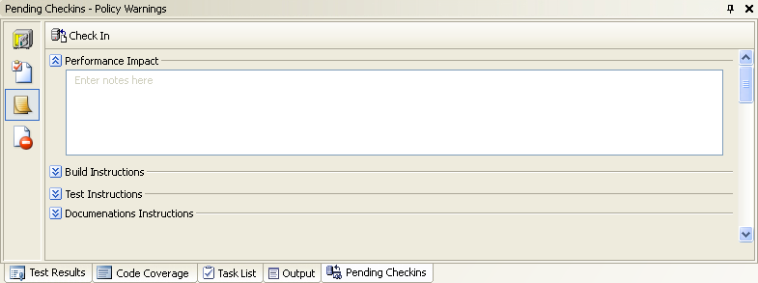
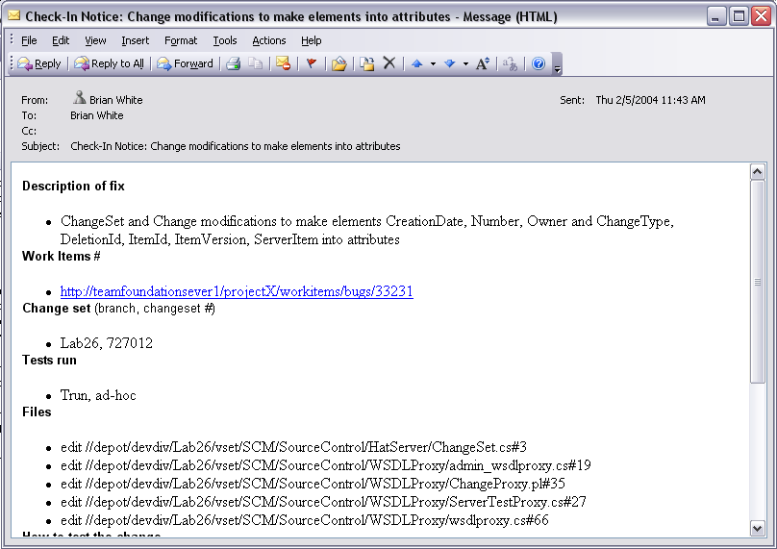
Checkin Notes and Notification
Entered at Checkin Time
Defined per Portfolio Project
Included in Checkin E-mail
Used in Build documentation as well
Notes:
There is a new check-in notes view where you can communicate other relevant information to your team. This is even customizable to include whatever fields/information your team requires as part of the ‘process’ setup. All the data you enter here is automatically persisted in the repository and included in the email which VSTS sends on your behalf.

Slide 30
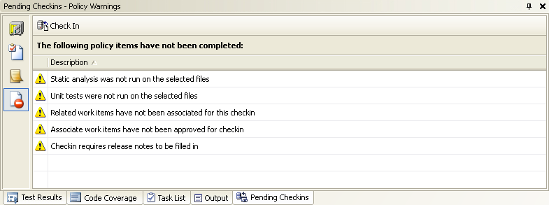
Validate Policy Detail
SCC Policy Engine
Policy Definitions
.NET Assemblies
Return Pass or Fail and message
Customer Extensible
User Over-ridable
WI Association
Release Notes
Unit Testing
Static Analysis
Custom Policy
Notes:
There is a new Policy Warnings view showing any policy violations. Policies are established as part of your process. For example, you may require that developers run static analysis prior to check-in and/or that all checkins are associated with one or more work items (these two policies actually ship oob with MSF 4.0 and enable great work item tracking features)
Policies can be fully customized (and allowed to be overridden – with PM getting notif’n email). New policies are simple to plug into the framework.

Slide 31
Source Code Control
Parallel Development
Multiple Releases
  Branching
  Merging
Multiple Checkouts
Shelving
  Interrupted workflow
  Transfer changes without checkin
  Checkpoint or share work in progress
Notes:
Effective branching and merging is essential to any SCM tool. Branching appears very similar to VSS and Source Depot in that a new copy of the files is created in the repository. There is more to it however, since a relationship is established and maintained between the original and the branch. All changes can therefore easily be tracked including which have been ‘merged’ between the two.
Hatteras contains new and powerful merging capabilities which supports not just changes but also additions, deletions, renames etc. You can run merge candidate queries to see what still requires merging and can even cherry-pick what gets merged when. E.g. show me everything in one branch which needs to be merged into the original. The query returns a list of changesets which need to be moved over. Remember a changeset is an atomic (transactional) package which makes change management a great deal easier.
The ability for developers to simultaneously checkout the same file(s) is now turned on by default. In VSS it was off by default and very few people were brave enough to turn it on. Now with the new merging capabilities, it is easy for one developer to check in their file and a subsequent developer to do the same resolving any minor conflicts where necessary before they turn into major conflicts.
Shelving is probably one of the most talked about and eagerly anticipated new features of source code control.
Interrupted workflow
Imagine you’re working on some new feature and an urgent bug fix requirement comes in.
Now you can shelve your changes, restore your workspace to the original (unmodified) files
You can then fix the bug and check it in before finally unshelving your original work which will also merge in the bug fix!
Also, imagine you need to transfer your work between your laptop and desktop or even transfer it to another developer. You can simply shelve it and then unshelve it on another machine.
Shelving is also great for backing up your work in progress.
Shelving takes care of creating private branches in the repository for you and then cleaning them up when you unshelve.

Slide 32
Source Code Control
Remote Development
Remote development is a reality
  Distributed teams, at-home, offshore
A system built for the Internet
  Web service protocols
  Browser-based clients
  Compatible with proxies and firewalls
  Optimized for high-latency networks
Notes:
Remote development is certainly becoming more pervasive with offshore and other distributed teams and even working from home.
Since Hatteras is designed around Web service protocols it is highly optimized for high-latency type networks.

Slide 33
Exploring Team Foundation Source Control
Notes:
Walkthrough: Exploring Team Foundation Source Control
"Exploring Team Foundation Source Control" demonstrates source control integration features in Visual Studio 2005.
Introduction
This walkthrough describes how to start using source control in the Visual Studio 2005 Team System integrated development environment (IDE). In particular, it describes how to:
-Set Team Foundation as your default source control plug-in for Visual Studio 2005.
-Locate and connect to a Team Foundation Server and source control repository from the Visual Studio 2005 IDE.
-Create a local workspace in which to store, safely edit, and test your personal copy of items in the source control repository.
-Create a development project in your local workspace and thereby prepare it for addition to the source control repository from within Visual Studio.
-Add a file to the source-controlled project and edit an existing one.
-Commit all pending project changes in your local workspace to the source control repository.
The Instructor may either walkthrough the tutorial, or present the video. If you do the video, then the walkthrough should be the hands-on lab. If the walkthrough is demonstrated, then the student should still go through the walkthrough as a hands-on.

Slide 34
What is VS Team Foundation?
Work Item Tracking
Source Code Control
Reporting
Build Automation
Team Communications

Slide 35
Build Automation
Out-of-the-box daily build
Good build process is hard to achieve
  Many shops don’t even bother
Goal: make it trivial
  Builds are reproducible
  VS Projects are built directly
  Builds are scheduled or on-demand
  Build report is centrally published
Goal: tight integration with VS Team System tools

Slide 36







Build Automation Steps
Build initiated from server
Create a build ID
Document build environment
Sync sources
and tools
Compile and analyze
Execute
tests
Update
work items
Calculate code coverage
Calculate code churn
Produce build report
Publish
build
Notes:
You will be able to initiate a build on the server, so you can kick-off a nightly build on the remote machine that you have identified. A unique ID is created first.
What happens on the machine itself is MS Build. After the build has happened, you can run against any kind of test you have. You can determine what set of change sets occurred,
Next, can calculate things like code coverage, code churn, and then a build report will get produced and published to project site. In morning, people can see what the results of that nightly build.
How it knows what files to compile is completely flexible. How that is configured is depending on your process. Default is likely latest files.

Slide 37
What is VS Team Foundation?
Work Item Tracking
Source Code Control
Reporting
Build Automation
Team Communications

Slide 38
Project Site
Facilitates team communication
  Specs, discussions, announcements, lists
  Work items, reports, public builds
Lightweight access for casual stakeholders
Built on Windows Sharepoint Services
Notes:
We will create a WSS sharepoint site at time of project creation. Place for docs, specs are stored, access to all reports, (public builds). Based on WSS, not full sharepoint structure.

Slide 39
What is VS Team Foundation?
Work Item Tracking
Source Code Control
Reporting
Build Automation
Team Communications

Slide 40
Reporting
Provides system-wide data view
Ships with many beneficial reports
  You can customize or add more
Built on SQL Server Reporting Services
Notes:
Will provide a whole number of reports (about 50 of them). But is also flexible for building your own reports. All based on SQL Reporting engine.
Example Reports
Project Health Report
Code churn and bugs by developer
Getting this organized in one report given all the historical information is very valuable.

Slide 41
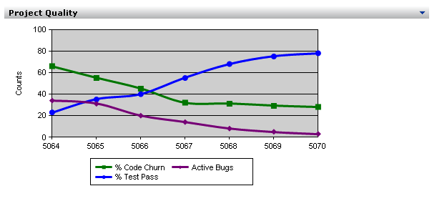
Reporting

Slide 42
Agenda
Software Configuration Management
Team Foundation Capabilities
Team Foundation Architecture
Notes:
Let’s have a look now at the architecture of the Team Foundation Server.

Slide 43
Visual Studio Team Foundation Architecture
Visual Studio
Office System
VS Packages
MS Excel
Plug-in
MS Project
Plug-in
Command
Line
…
IE
…
Team Foundation Object Model (Managed API)
SOAP / HTTP(S)
ASP.NET
WSS
Team Foundation Integration Services
Team Portal
Eventing and
Notification Service
Linking Service
Registration
Service
Web Parts
Team Foundation Data Services
Rosetta
Work Item Service
Source Code
Control Service
Build Data Services
Reports
MSSQL/TCP
SQL
Team Foundation Data-Tier
WI
(Product Studio)
SCC
Methodology
Build Data
Build Results
Test Results
Code Coverage
Static Analysis
Warehouse
Notes:
NOTE: See Architecture video from Devlab for more information…
TF data-tier is based on SQL Server (Yulon required). All operational stores (methodology, biuld data, code, etc). Data Warehouse (with OLAP cubes) lives here as well. In V1, you can put on its own box.
2nd level, is app / Middle tier. Put together with a set of web services. Feature oriented WS but also integration WS (I’m a new tool out here and I want to be plugged into VSTS). We use this ourselves to link in our features. We have a eventing and notification events service, a cross tool communication method. All these will be publicly exposed.
All communication between Datatier and Middletier is SQl, between MT and client is SOAP.
We will not support scale out to suport cluster or replicated. On client side we have a managed API with functionality to hash manage info to the MT. We expect most extensibility will go through here.
We will have a comflict resolution to help if someone syncs form Excel a the same time as another.
Team portal has a set of Web services focused mainly on reporting.
APIs will be published and we are working on libraryies (available early fall). We have a line of partners interested in building extensbility.

Slide 44


Extensibility
End user extensibility – process customization
  Work Item Types
  Checkin Notes & Policies
Third party extensibility
  Tool integration platform – eventing, linking, security
  Managed object models
  Web service APIs
Notes:
In case you haven’t picked this up by now, Extensibility is a key message in VSTS and this is evident in WIT and SCC.
As discussed, the ability to fully customise the work items and types and implement your own policies and processes when checking in makes it easy to fit in with your own organisation and team structure.
Third parties can use the client APIs to include source code control in their own tools if they wish.
Tools can even request event notifications from the repository; for example pre and post check-in, check-out etc.

Slide 45
Summary
Discussed Software Configuration Management (SCM)
Learned about the SCM features in Team System
Understood the architecture of Team Foundation
Learned about the options for extensibility
Notes:
So that’s it.
Hopefully you can see how the new work item tracking and source control systems in Team Foundation really do integrate and extend to provide the sort of software configuration management experience we’d all like to have.
--------------------------------------------------------------------
Other useful Haterras details.
It has a command line interface
Supports compressed files up to 4gb for e.g. media files
Has a .NET object model for integration plus a Web Service API for server integration (so does new VSS!)
Everything uses GMT in the repository. Times are converted to local times on individual clients.
Everything is stored in SQL Server (Yukon) so can take advantage of e.g. Backups.
Conversion tools will be provided for VSS, ClearCase and SourceDepot which preserve all the history etc.

